Slide 1
WELCOME TO CSE 360 PRESENTATION EAST WEST UNIVERSITY

Slide 2

➔ MICROPROCESSOR BASED AUTOMATIC ATTENDANCE RECORDER
PROJECT NAME

Slide 3
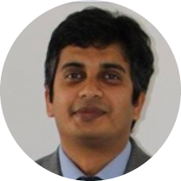
INSTRUCTOR
Md. Sawkat Ali
Assistant Professor
Department of Computer Science and Engineering
East West University

Slide 4



TEAM PRESENTATION
Mridul Ranjan Karmakar ID – 2018-3-60-021
Department of Computer
Science and Engineering
Mohsenul Kabir Mithun ID – 2019-3-60-046
Department of Computer Science and Engineering
Md. Asif Imtiyaj Chowdhury ID – 2019-3-60-115
Department of Computer
Science and Engineering

Slide 5
INTRODUCTION
What is microcontroller?
What is RFID?
RIFD’s working process
Real life application

Slide 6
OBJECTIVES
Take automatic attendance
Prevent outsider
Reduce manually work
Save Time

Slide 7
EQUIPMENT & COMPONENTS
➔Necessary components to build Microcontroller based automatic attendance system
1. 8051 Microcontroller (AT89C51) 2. Alphanumeric 16x2 LCD Display 3. RFID Rider 4. Wire

Slide 8
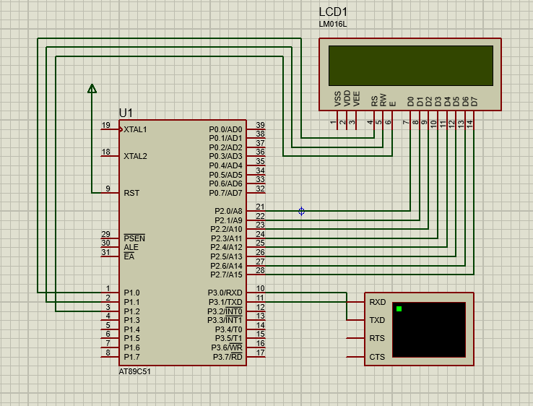
DESIGN
Design of Microprocessor based automatic attendance recorder with RFID system

Slide 9
IMPLEMENTATION
➔ Implementation Steps:
1. Initialize the LCD 2. Initialize the Serial Communication (9600 Baud Rate) 3. Receive the 13 bytes and check 4. And display them into the LCD Display.
In this project, we use only 13 bytes of student id given by our university. But we can take any arbitrary number. If it is matching it can run the motor.

Slide 10
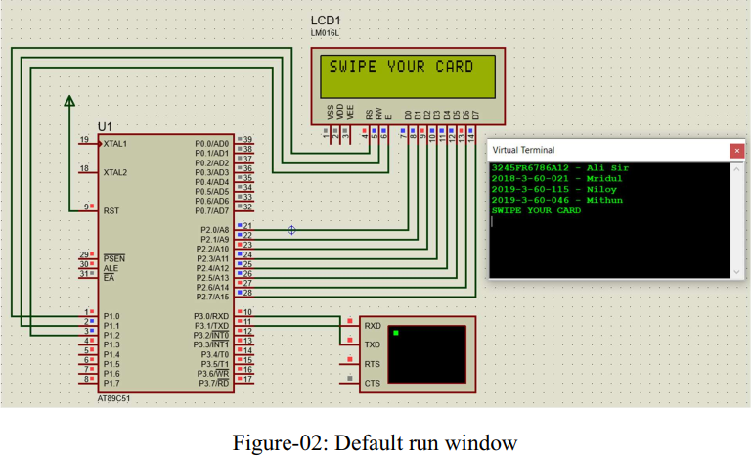
DEBUGGING – TEST RUN

Slide 11
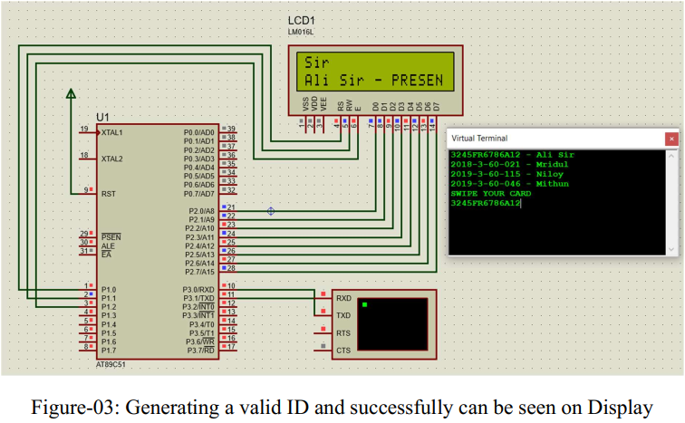
DEBUGGING – TEST RUN

Slide 12
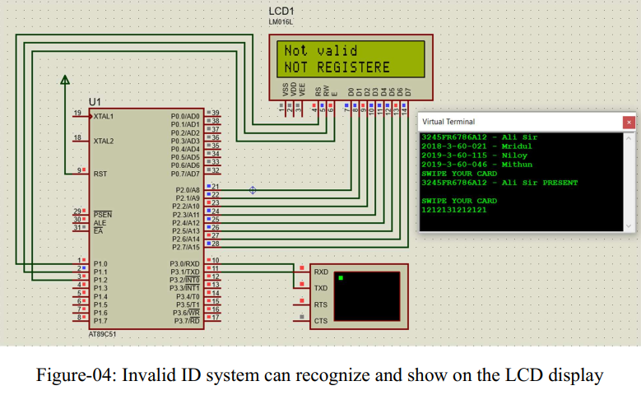
DEBUGGING – TEST RUN

Slide 13
CONCLUSION
Run perfectly, no implementation error
Interconnected to each other
Operate the process perfectly.
FUTURE IMROVMENTS
Time management system
Automatic act
Sound System

Slide 14
BIBLIOGRAPHY
➔References of online Resources/Articles:
https://www.electronicwings.com/8051/8051-uart
https://www.camcode.com/asset-tags/what-are-rfid-tags/
https://www.circuitstoday.com/rfid-based-attendance-system
https://www.projectsof8051.com/rfid-based-attendance- managementsystem/

Slide 15

THANK YOU

